Slide 1
Intensity calculated from the mean pixel value of segmented area in the range of 0~255, 0 is pure dark, 255 is pure white.

Slide 2
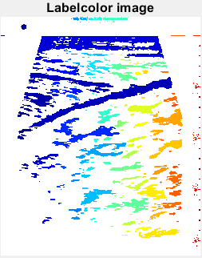
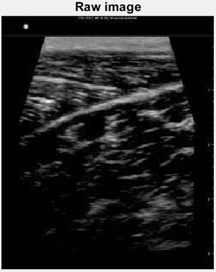
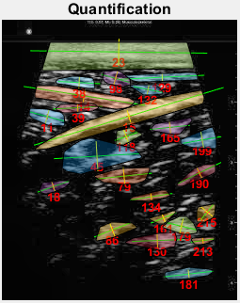
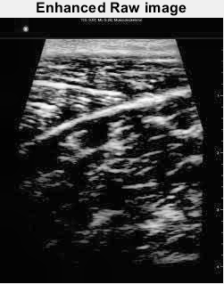
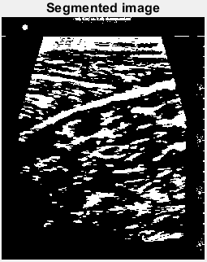
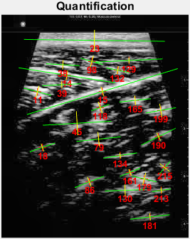
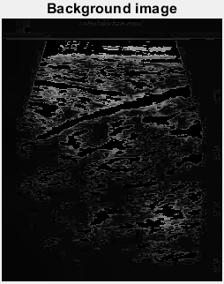
Background area (px²): 60573
Background intensity (0~255): 22.0585
Img1 | Index | Major axis (px) | Minor axis (px) | Area (px²) | Orientation (o) | Intensity (0~255)
 | 11 | 38.02778 | 16.38642 | 392 | -14.9633 | 189.9464
 | 14 | 130.4078 | 13.15402 | 695 | -8.83598 | 202.6863
 | 15 | 210.6796 | 13.28229 | 1547 | 16.92655 | 186.638
 | 18 | 35.81503 | 10.38944 | 165 | 19.14474 | 89.68485
 | 23 | 188.1742 | 27.9349 | 2433 | -0.77942 | 178.7074
 | 38 | 44.71519 | 12.41903 | 225 | -3.20104 | 181.7289
 | 39 | 52.1321 | 8.763501 | 193 | 3.069866 | 183.3886
 | 45 | 91.77995 | 32.06525 | 791 | 3.357237 | 148.1732
 | 79 | 59.27738 | 18.97965 | 395 | 5.939705 | 133.7089
 | 86 | 41.64283 | 14.08989 | 341 | 21.38338 | 113.044
 | 98 | 30.74794 | 15.56399 | 180 | -15.8671 | 162.4611
 | 118 | 25.65699 | 16.65254 | 219 | 19.78309 | 161.2648
 | 129 | 89.84854 | 7.388656 | 301 | 2.717739 | 145.3721
 | 130 | 54.08085 | 15.26724 | 383 | 2.115351 | 140.1462
 | 132 | 31.31035 | 10.4551 | 180 | -11.5892 | 166.2056
 | 134 | 45.54436 | 7.212525 | 189 | 8.931813 | 125.9259
 | 161 | 29.41958 | 9.417965 | 115 | 22.02359 | 121.9043
 | 165 | 42.35726 | 12.26895 | 293 | 5.920296 | 164.5734
 | 179 | 33.43696 | 16.55585 | 336 | -13.5363 | 171.1458
 | 181 | 53.28432 | 9.47803 | 307 | 6.489848 | 95.36156
 | 190 | 51.14189 | 11.88412 | 286 | 26.08783 | 118.8706
 | 199 | 41.07325 | 17.96225 | 402 | 9.988049 | 155.0448
 | 213 | 25.56788 | 7.495236 | 117 | 7.915138 | 120.9829
 | 215 | 21.84198 | 16.82333 | 171 | 50.74533 | 112.4737
Segmented fibers:

Slide 3
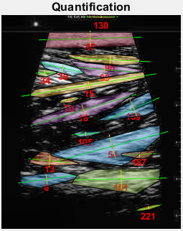
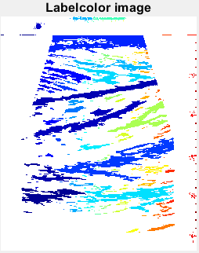
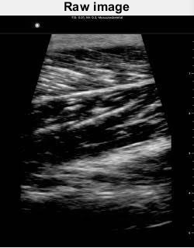
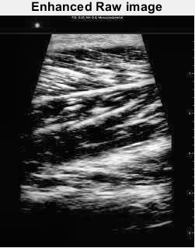
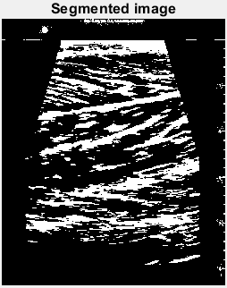
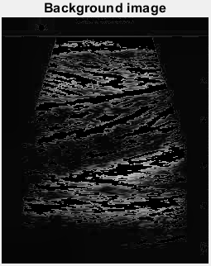
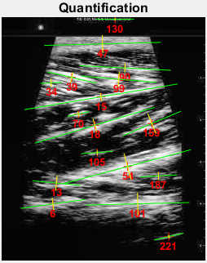
Img2 | Index | Major axis (px) | Minor axis (px) | Area (px²) | Orientation (o) | Intensity (0~255)
 | 6 | 79.99332 | 14.74676 | 709 | 7.801008 | 162.4965
 | 13 | 59.04601 | 18.55236 | 395 | -5.56383 | 157.1848
 | 15 | 190.5257 | 9.14847 | 1025 | 9.492167 | 196.0234
 | 18 | 153.1016 | 16.72843 | 1237 | 16.62634 | 169.8707
 | 34 | 26.13754 | 10.04436 | 121 | 2.601985 | 182.595
 | 39 | 61.73378 | 12.64682 | 444 | -12.9851 | 213.2072
 | 47 | 143.1374 | 21.58856 | 1734 | 1.524016 | 168.2341
 | 54 | 160.5118 | 32.72223 | 2038 | 14.8722 | 201.369
 | 70 | 27.37541 | 6.19214 | 122 | 11.85919 | 178.3279
 | 90 | 112.1489 | 11.42322 | 456 | -2.94453 | 178.5965
 | 99 | 92.33123 | 19.19101 | 604 | -4.74181 | 210.4437
 | 101 | 126.9828 | 27.04718 | 1324 | 1.384486 | 184.8066
 | 105 | 38.7907 | 6.671103 | 139 | 4.277396 | 109.6043
 | 130 | 46.8719 | 3.673007 | 112 | 0.02778 | 95.66964
 | 159 | 77.59663 | 26.50893 | 705 | 22.84523 | 163.295
 | 187 | 45.04589 | 9.857875 | 154 | 3.106831 | 132.8766
 | 221 | 37.35615 | 4.355789 | 114 | 13.47674 | 102.2544
Background area (px²): 60475
Background intensity (0~255): 28.4506
Segmented fibers:

Slide 4
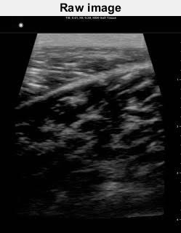
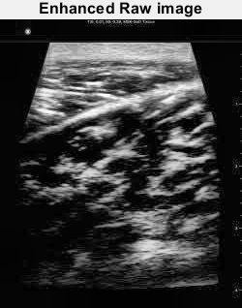
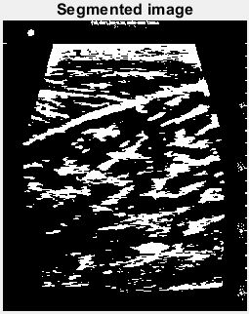
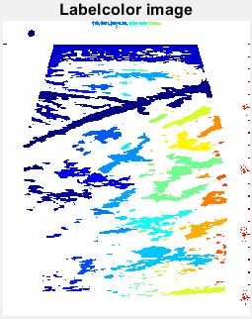
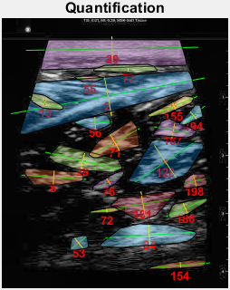
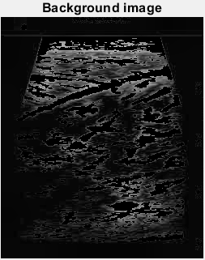
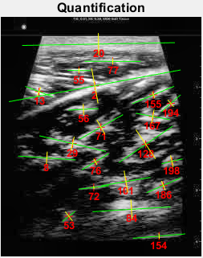
Background area (px²): 60064
Background intensity (0~255): 28.4468
Segmented fibers:
Img3 | Index | Major axis (px) | Minor axis (px) | Area (px²) | Orientation (o) | Intensity (0~255)
 | 2 | 217.4179 | 44.52328 | 2220 | 10.45826 | 188.0041
 | 8 | 71.86639 | 15.79526 | 465 | -3.84003 | 120.1548
 | 13 | 36.68917 | 11.95908 | 235 | -20.8073 | 191.6043
 | 20 | 190.3557 | 27.17678 | 2408 | 1.049158 | 182.0278
 | 29 | 85.14343 | 17.93205 | 718 | -13.239 | 153.5279
 | 53 | 19.94117 | 14.69571 | 164 | 37.78359 | 90.20122
 | 55 | 28.74807 | 5.88555 | 105 | -0.79043 | 197.8
 | 56 | 37.42616 | 13.61921 | 310 | 2.978984 | 160.9226
 | 71 | 63.04011 | 20.86135 | 529 | 29.4732 | 146.6654
 | 72 | 37.61278 | 4.236896 | 111 | 6.285129 | 111.0721
 | 76 | 39.47357 | 8.911044 | 222 | 30.96673 | 130.9324
 | 77 | 70.12429 | 7.234777 | 291 | -0.11259 | 185.2955
 | 84 | 97.44127 | 23.98658 | 957 | 3.536758 | 162.7335
 | 101 | 62.08096 | 27.25877 | 573 | 9.624786 | 148.2251
 | 128 | 81.11607 | 43.60878 | 1106 | 34.04597 | 151.2089
 | 154 | 65.4806 | 6.481118 | 277 | 4.762476 | 90.51625
 | 155 | 56.63196 | 8.066372 | 294 | 22.72734 | 160.6803
 | 167 | 43.2176 | 17.52685 | 394 | -10.7248 | 168.6269
 | 186 | 45.87732 | 12.36914 | 335 | 23.52096 | 127.4358
 | 194 | 32.55011 | 11.19469 | 178 | 41.03678 | 144.6404
 | 198 | 26.77688 | 15.05186 | 240 | 13.11128 | 125.3792

Slide 5
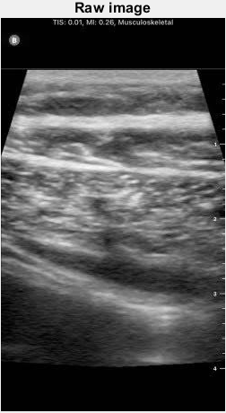
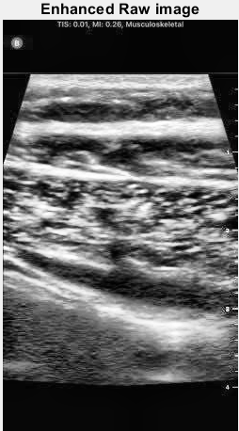
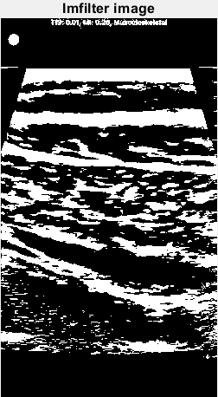
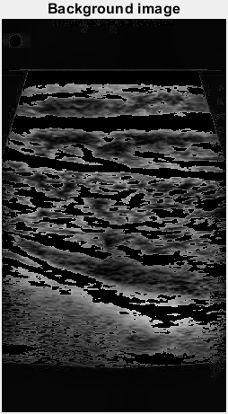
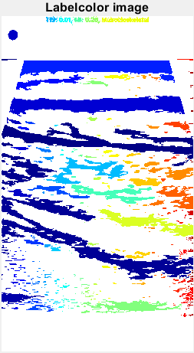
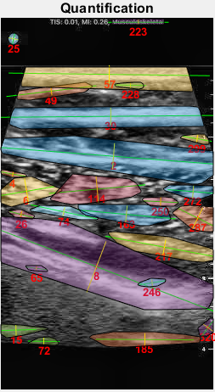
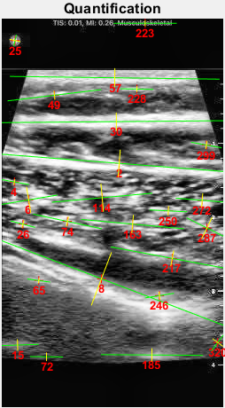
Background area (px²): 80434
Background intensity (0~255): 55.3859
Segmented fibers:
Img4 | Index | Major axis (px) | Minor axis (px) | Area (px²) | Orientation (o) | Intensity (0~255 px)
 | 2 | 295.1899 | 30.94306 | 3645 | -4.4328 | 210.0477
 | 4 | 33.72346 | 5.999696 | 126 | -10.3321 | 173.9762
 | 6 | 65.94267 | 29.92078 | 990 | 9.52122 | 203.9242
 | 8 | 312.6797 | 63.99439 | 5470 | -20.824 | 203.1622
 | 15 | 47.57484 | 13.0689 | 391 | 1.832915 | 113.0563
 | 25 | 13.46569 | 12.58317 | 132 | 77.09977 | 135.5985
 | 26 | 28.76944 | 8.567305 | 154 | -14.8355 | 198.5455
 | 30 | 266.779 | 20.55418 | 3713 | 0.497099 | 214.8233
 | 49 | 106.6247 | 9.892765 | 534 | 6.856995 | 172.1629
 | 57 | 236.791 | 21.55629 | 3218 | -0.75631 | 200.8797
 | 65 | 26.17803 | 6.071654 | 105 | -7.89146 | 182.8762
 | 72 | 37.25353 | 9.345437 | 127 | -0.63836 | 80.16535
 | 74 | 79.13478 | 11.12793 | 361 | -12.0208 | 210.9778
 | 114 | 113.7945 | 31.87125 | 1193 | 5.132179 | 203.5256
 | 163 | 116.4256 | 20.81914 | 966 | -5.18388 | 190.4669
 | 185 | 115.3013 | 14.88984 | 1008 | -0.38978 | 121.7103
 | 217 | 141.3077 | 18.04836 | 1345 | -10.5755 | 166.1108
 | 223 | 71.37311 | 6.526387 | 279 | -0.01462 | 111.2401
 | 228 | 37.15801 | 6.473622 | 143 | -1.09362 | 187.7692
 | 246 | 33.13609 | 8.721869 | 146 | 9.088013 | 184.7055
 | 250 | 42.46215 | 10.59463 | 309 | -2.94637 | 199.3948
 | 272 | 59.78326 | 15.92215 | 460 | -4.54791 | 179.4913
 | 287 | 51.61786 | 26.82972 | 662 | -26.511 | 174.6224
 | 299 | 35.00679 | 8.774883 | 197 | -10.1526 | 153.0508
 | 320 | 23.43186 | 14.56864 | 135 | 53.35903 | 99.08889

